Slide 1

Seller Support Tools
Quick Guide

Slide 2





In this presentation you will find information about the following tools:
Seller Central
Paragon
SPOT
Knowledge Center
Standard Resolution Document
W.amazon.com

Slide 3

Direct link: https://sellercentral.amazon.com
When should I visit this tool?
Find Help Pages
Replicate the seller’s issue
Use it to walk through your seller
Is this tool Seller facing?
Yes

Slide 4
Direct link: https://paragon-na.amazon.com/hz/lobby
When should I visit this tool?
Accept and manage cases (Reply to seller)
Use the Paragon Workflow when applicable
Research using previous cases
Is this tool Seller facing?
No

Slide 5
Direct link: SPOT (Hiperlink)
When should I visit this tool?
See Seller Central internally( see information that the seller can’t see).
Review order details, payments information and account statuses that are not displayed in Seller Central.
Is this tool Seller facing?
No

Slide 6

Direct link: KC (Hyperlink)
When should I visit this tool?
Find SOP’s and Blurbs
Use the links from this page as a back up on your standard annotations.
Is this tool Seller facing?
No
Find more information about this tool on the next page:

Slide 7
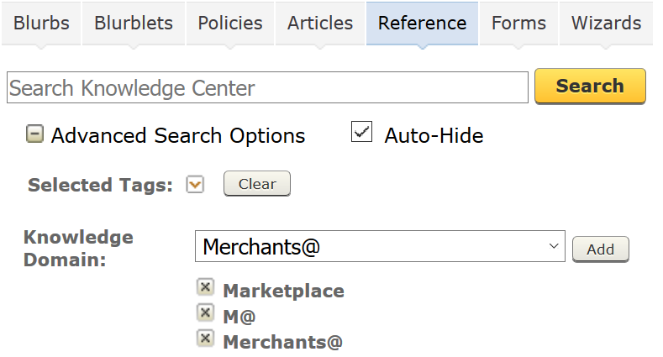
Find templates
Find SOP’s
Always make sure you have these 3 Domains selected

Slide 8
SRD’s
Direct link: SRD’s (Hyperlink)
When should I visit this tool?
The Standard Resolution Document can be used to find help pages, SOP’s, Atlas Card correct selection, Reason Codes.
Always remember to use the search bar on the right in order to get quicker results. Remember to use Ctrl + F when navigating through this tool.
Is this tool Seller facing?
No

Slide 9
w.amazon.com
Direct link: http://w.amazon.com/
When should I visit this tool?
Acronym Central
Hdrive Mapping Instructions
Always rely on the SOP’s and Help Pages when you need to research on a seller’s case. However, this could be a useful tool to find more information related to Amazon Services, acronyms and even procedures to help our sellers. Note: Keep in mind this tool works like Wikipedia, in which the information may not be 100% trustful. Therefore, make sure to back up the information with the SOP or your AA’s
Is this tool Seller facing?
No

Slide 10

Thank you

